Slide 1
Software Project Management
Chapter 2. Software Project Planning

Slide 2
Create the Project Plan
The project plan defines the work that will be done on the project and who will do it. A typical project plan consists of:
A statement of work that describes all work products that will be produced and a list of people who will perform that work.

Slide 3
Continue…
A resource list that contains a list of all resources that will be needed for the product, and their availability
A work breakdown structure and a set of effort estimates
A project schedule
A risk plan that identifies any risks that might be encountered and indicates how those risks would be handled, should they occur

Slide 4
Statement of Work
The first component of the project plan is a statement of work (SOW).
This is a detailed description of all of the work products that will be created over the course of the project, including who is responsible for creating each work product.

Slide 5
Continue…
The SOW is included as part of the project plan, but it should be a separate document that can stand on its own. It should contain each of the following:
The list of features being developed. If the software is being released in phases, the features should be divided into those phases as well.
A description of the intermediate deliverable or work product that will be built.
The estimated effort involved for each work product to be delivered (possibly based on the results of the Wideband Delphi estimation session), if known.

Slide 6
Resource List
The project plan should contain a list of all resources that will be used on the project.
This list should go beyond what’s covered by the project schedule by including a description of each resource, as well as any limits on that resource’s availability.

Slide 7
Estimates and Project Schedule
Once the statement of work and the resource list have been created, the project manager should build a project schedule. This is usually done in several steps:
A work breakdown structure (WBS) is defined. This is a list of tasks that, if performed, will generate all of the work products needed to build the software.
An estimate of the effort required for each task in the WBS is generated.
A project schedule is created by assigning resources and determining the calendar time required for each task.

Slide 8
Risk Plan
A risk plan is a list of all risks that threaten the project, along with a plan to mitigate some or all of those risks.
Risk assessment is an important part of planning a software project because it allows the project manager to predict potential problems that will threaten the project and take steps to mitigate those problems.

Slide 9
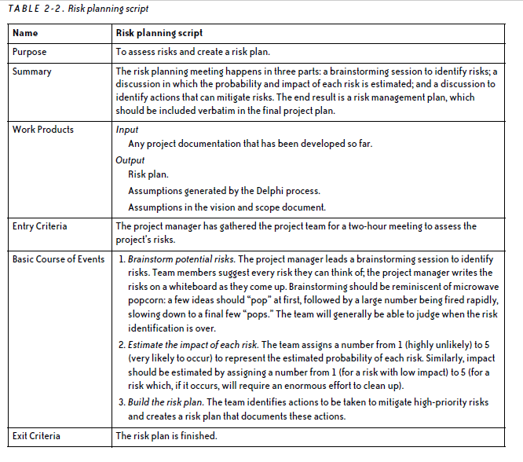

Slide 10
Brainstorm potential risks
Risks should be as specific as possible. It’s true that “The project might be delayed” or “We will go out of business” are risks; however, they are far too unclear to do anything about.
When a unclear risk comes up, the project manager should push the team into making it more specific.
The team should go through them and evaluate each assumption for potential risks as part of the risk brainstorming session.

Slide 11
Estimate the impact of each risk
Once the team has generated a final set of risks, they have enough information to estimate two things:
a rough estimate of the probability that the risk will occur,
and the potential impact of that risk on the project if it does eventually materialize.
The risks must then be prioritized in two ways: in order of probability, and in order of impact

Slide 12
Continue…
The numbers for probability and impact are assigned to each risk; a priority can then be calculated by multiplying these numbers together.
After the probability and impact of each risk have been estimated, the team can calculate the priority of each risk by multiplying its probability by its impact.

Slide 13
Make a mitigation plan
The team can take any or all of these actions to mitigate a risk:
Alter the project plan. The project schedule can be adjusted to help reduce the risk. Riskier tasks can be moved earlier in the project, or given more time.
Add additional tasks. There are certain actions that can be added to the schedule to help avoid risks.
Plan for risks. For risks with a high impact that do not need specific tasks or project plan changes, the project manager should have the team spend a few minutes identifying the steps that should be taken in case the risk does occur.

Slide 14
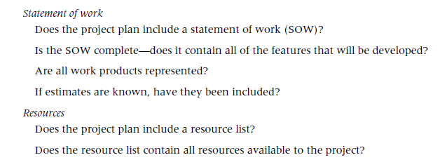
Project Plan Inspection Checklist

Slide 15
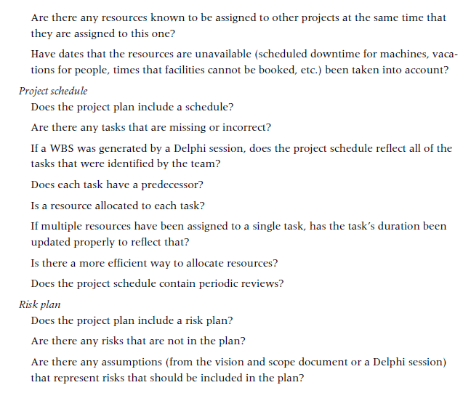

Slide 16
Diagnosing Project Planning Problems
If the project manager does not take the lead in defining the scope immediately, the project will quickly become chaotic.
Even if the scope seems to be defined well, the project manager must make sure that all stakeholders really understand and agree to it in order to avoid problems later on in the project

Slide 17
Lack of Leadership
Without good leadership, the team member might be afraid to make this decision.
This usually results in the team member sending emails to peers, managers, stakeholders, and anyone else she can find, requesting confirmation of absolutely every little decision that gets made.
People quickly get inundated with notes about project details that they lack the context to even understand.

Slide 18
The Mid-Course Correction
A change in the project priorities partway through the project is one of the most frustrating ways that a software project can break down.
This, in turn, wreaks havoc on the project schedules, causing the team to miss important deadlines as they frantically try to go back and hammer the new feature in.

Slide 19
The Detached Engineering Team
In many organizations, there is an artificial wall between the people who need the software and the people who build it.
The engineering team often sees itself as a separate unit.
The priorities of the people in the organization who need the software don’t really figure into the way the engineers plan and carry out their work.

